Slide 1
BASIC SORTING TECHNIQUES
REVISION

Slide 2
Bubble Sort
Approach:
Compares the adjacent elements
Swaps the elements if they are in wrong order.
procedure bubbleSort( list : array of items )
loop = list.count;
for i = 0 to loop-1 do:
swapped = false
for j = 0 to loop-1 do:
if list[j] > list[j+1] then /* swap them */
swap( list[j], list[j+1] )
swapped = true
end if
end for
if(not swapped) then
break
end if
end for
end procedure return list

Slide 3
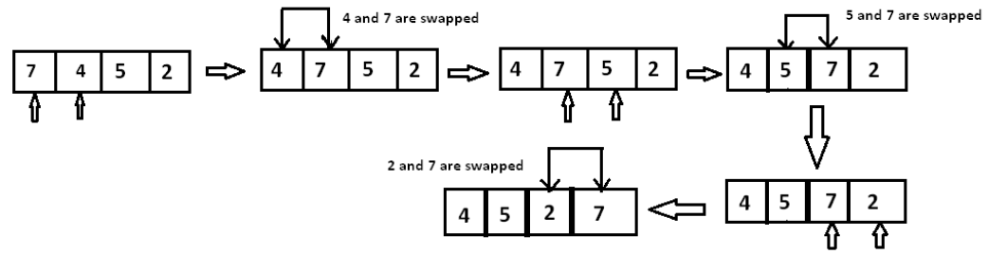
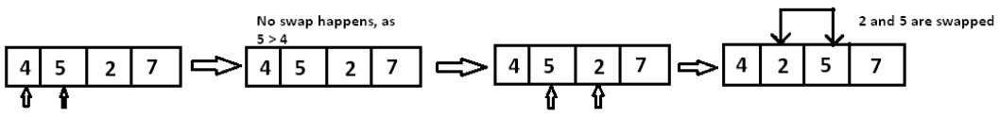
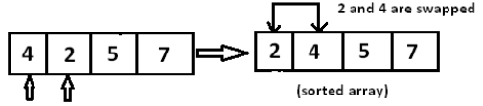
Bubble Sort
Sort array a= [7, 4, 5, 2] in increasing order

Slide 4
Bubble Sort
Sort array a1= [60, 50, 40, 30, 20, 10]
Pass= n-1
Swaps= O(n^2)
Comparisons O(n^2)
Sort array a2=[10, 20, 30, 40, 50, 60]
Pass= 1
Swaps= 0
Comparisons=O(n)

Slide 5
Selection Sort
Approach
Find the minimum or maximum element in an unsorted array
Put it in its correct position in a sorted array.

Slide 6
Selection Sort : Pseudocode
procedure selection sort list : array of items n : size of list
for i = 1 to n - 1
min = i /* set current element as minimum*/
for j = i+1 to n
if list[j] < list[min] then /* check the element to be min*/
min = j;
end if
end for /* swap the minimum element with the current element*/
if indexMin != i then
swap list[min] and list[i]
end if
end for
end procedure

Slide 7
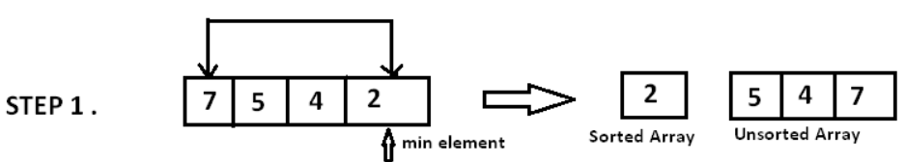
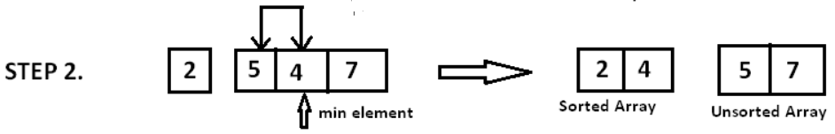
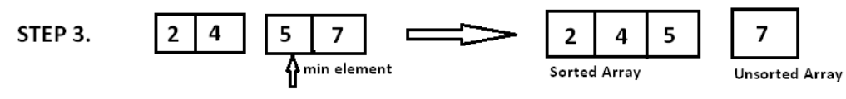
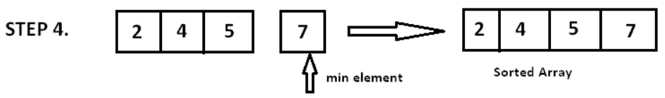
Selection Sort
Approach

Slide 8
Selection Sort
Sort a=[60, 50, 40, 30, 20, 10]
Pass= O(n)
Swaps= O(n)
Comparisons= O(n^2)
Sort a=[10, 20, 30, 40, 50, 60]
Pass= O(n)
Swaps= 0
Comparisons= O(n^2)

Slide 9
Insertion Sort
Approach:
It considers part of a list sorted and rest of the list as unsorted.
Then continuously picks elements from the unsorted part and puts them at appropriate position in the sorted list by shifting the elements to right.

Slide 10
Insertion Sort
Approach:
INSERTION-SORT(A)
for i = 0 to n-1
temp ← A [i]
j ← i
while j > 0 and A[j-1] >temp
A[j] ← A[j-1]
j ← j – 1
End while
A[j] ← temp
End for

Slide 11
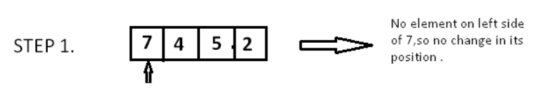
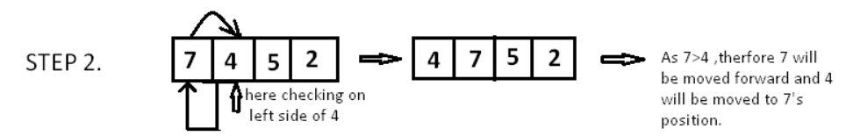
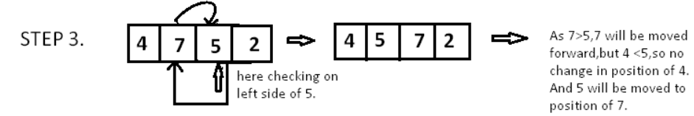
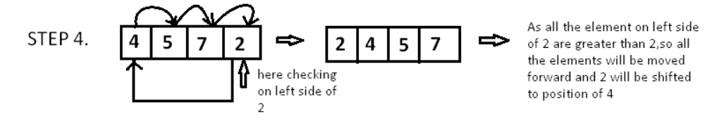
Insertion Sort

Slide 12
Insertion Sort
Analysis:
Passes= (n-1)
Comparisons depend upon N
Best case: O(N)
Worst case:O(N^2)
Fewer swaps

Slide 13
Insertion Sort
Sort a=[60, 50, 40, 30, 20, 10]
Pass=O(n)
Swaps=O(n^2)
Comparisons = O(n^2)
Sort a=[10, 20, 30, 40, 50, 60]
Pass=O(n)
Swaps=0
Comparisons=O(n)

Slide 14
Merge sort approach
Merge Sort is a Divide and Conquer algorithm.
First divides the problem into sub-problems
Then solve each sub-problem
Merge sort consists of two main steps:
Divides the input array into two sub-arrays, calls itself for the two halves recursively.
Then merges the two sorted halves.

Slide 15



















Here l=r for LHS recursion. Hence call STEP 2 mergeSort on RHS
Here l=r for RHS recursion. Hence call STEP 3
i.e. Merge(a, l, m, r)

Slide 16
Merge Sort
Sort a=[60, 50, 40, 30, 20, 10]
Pass= O(Log n)
Swaps= O(n Log n)
Comparisons = O(nLogn)
Sort a=[10, 20, 30, 40, 50, 60]
Pass=O(Log n)
Swaps=0
Comparisons=(n Logn)
Space = O(n) for all cases

Slide 17
QUICK SORT
Divide and Conquer approach
It picks an element as pivot
Partitions the given array around the picked pivot.
Put all smaller elements (smaller than ‘pivot’) before it, and put all greater elements (greater than pivot) after it

Slide 18
QUICK SORT
Divide and Conquer approach
In Quick sort algorithm, partitioning of the list is performed using following steps...
Step 1 - Consider the first element of the list as pivot (i.e., Element at first position in the list).
Step 2 - Define two variables i and j. Set i and j to first and last elements of the list respectively.
Step 3 - Increment i until list[i] > pivot then stop.
Step 4 - Decrement j until list[j] < pivot then stop.
Step 5 - If i < j then exchange list[i] and list[j].
Step 6 - Repeat steps 3,4 & 5 until i > j.
Step 7 - Exchange the pivot element with list[j] element.

Slide 19
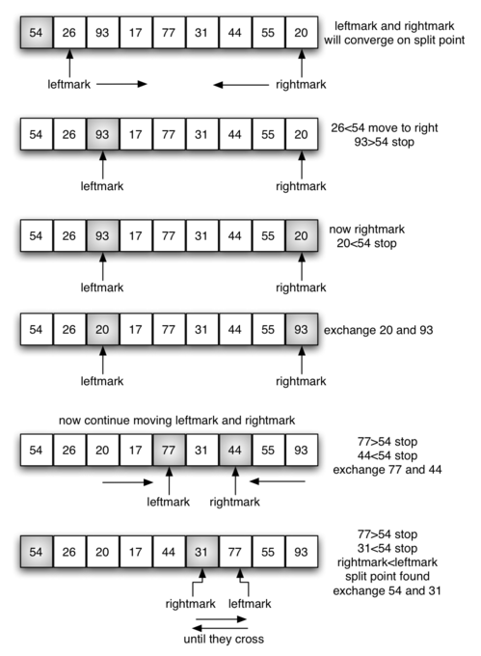

Slide 20
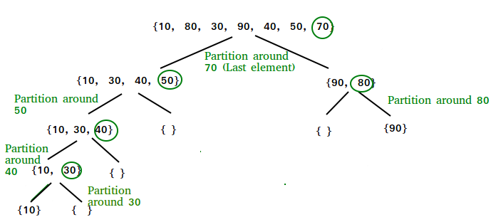

Slide 21
QUICK SORT
Best case – O(nlogn)
Average case (O(nlogn)
Worst case O(n^2)
10 20 30 40 50 60

Slide 22
Questions

Slide 23
Question-1
Online data stream refers to stream of data that is received
Constantly say 1 data per 0.1 second.
I want to sort this data which of the following sorting techniques will be useful?
Bubble Sort
Selection Sort 2, 1, 4 5 --- 0 3 8
Insertion Sort correct
Merge Sort
Quick Sort

Slide 24
Question-2
Suppose I want to sort my data that is placed in files.
But my system has a drawback of ‘COSTLY WRITES’. Which of
the following techniques is then helpful to sort the data?
Bubble Sort
Selection Sort 60 50 40 30 20 10 correct
Insertion Sort
Merge Sort
Quick Sort

Slide 25
Question-3
Suppose I have some data and it is pre-sorted. But I am unaware of its order and try to sort the data using some algorithm. Which of the following techniques is ill suited for sorting here?
10 20 30 40 50 60
Bubble Sort
Selection Sort correct
Insertion Sort
Merge Sort
Quick Sort correct

Slide 26
Question-4
Suppose I have some data given in random order in an array. I want to calculate the sum of any two numbers yielding maximum sum? Which of the following techniques can be used here efficiently?
Bubble Sort correct
Selection Sort correct
Insertion Sort
Merge Sort
Quick Sort

Slide 27
Question-5
Given a nearly sorted data. Which of the following techniques will be best suited to sort it
Selection Sort
Insertion Sort
Merge Sort
Quick Sort

Slide 28
Question-6
Which of the following techniques provides the best worst-case complexity but is still not found suitable to sort arrays?
Bubble Sort
Selection Sort
Insertion Sort
Merge Sort
Quick Sort

Slide 29
Question-7
A sorting technique is said to be stable if it doesnot change the order of the elements in which they arrive (consider 2 elements with same value)
Ex: 4, 4, 1, 3
After sorting 4 must come after 4 only.
Which of the following techniques are not stable?
Bubble Sort 60 10 10 20
Selection Sort 1 4 4 3 correct
Insertion Sort 10 30 20 20
Merge Sort
Quick Sort 10 11 44 44 10 55 60 correct

Slide 30
Question-8
Given the data in form of a list ‘L’. IF list ‘L’ is to be sorted which technique will be most efficient for it?
Bubble Sort
Selection Sort
Insertion Sort
Merge Sort correct
Quick Sort

Slide 31
Question-9
A sorting technique is said to be in-place if doesnot require any extra space for sorting.
Which of the following techniques are in-place sorting techniques, both practically and theoretically?
Bubble Sort correct
Selection Sort correct
Insertion Sort correct
Merge Sort
Quick Sort

Slide 32
Question-10
Considering the modified version of the sorting techniques studied till now. Which of the following techniques will be best suited for sorting arrays in its modified form. Consider the worst-case scenarios.
Bubble Sort
Selection Sort
Insertion Sort
Merge Sort
Quick Sort correct (Ans: Randomized quick sort)

Slide 33
Coding problems
Rearrange the array in form of a wave such that the data appears in a lexicographical manner.
A= 10, 5, 6, 9, 8, 12
out= 6, 5, 9, 8, 12, 10
1, 2, 3, 4
Out-1 = 4, 1 ,3, 2 // Incorrect
Out-2 = 2, 1, 4, 3 // Correct

